Slide 1
Big Data 510: Introduction to Data Engineering Project
New York City Yellow taxi Cab
Student: Benjamin Chan

Slide 2
Table of Content
Introducing the data sources
Objective of the project
Investigation
Results
Conclusion & Time Constraints

Slide 3
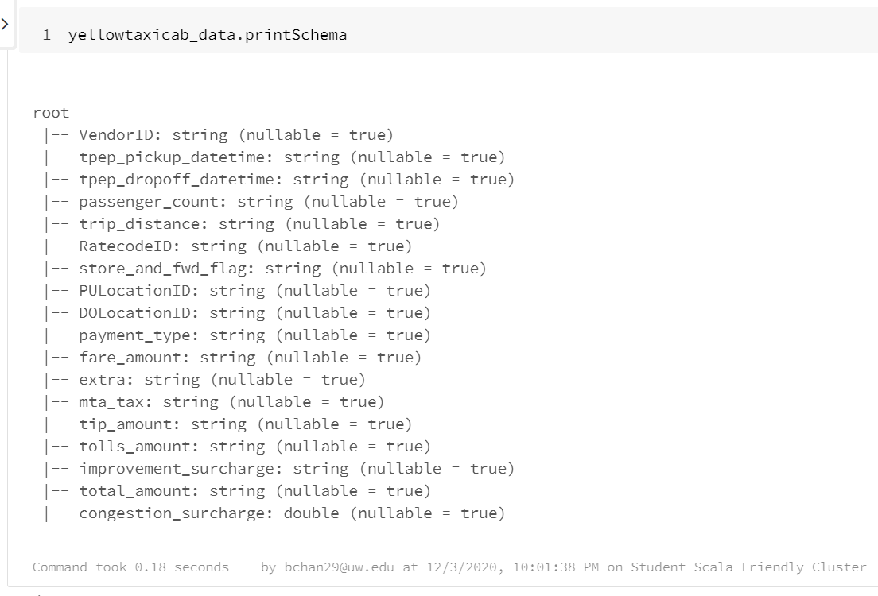
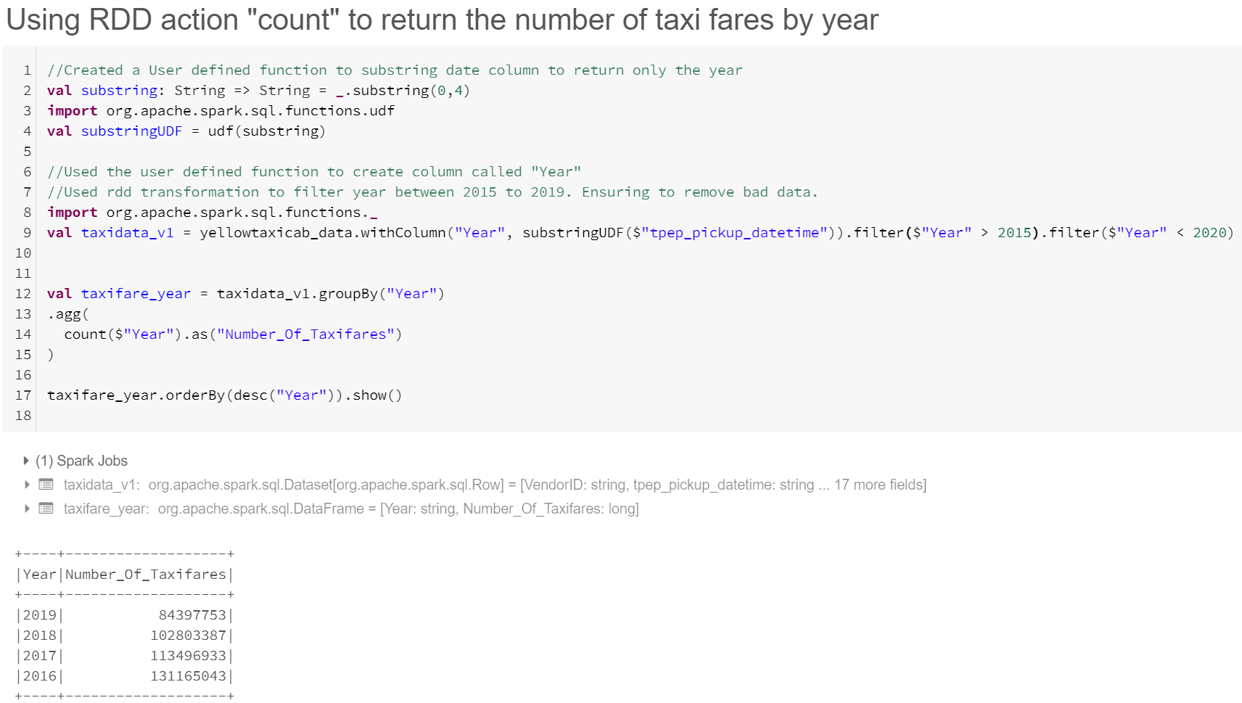
Introducing the data sources
Data source #1 captures yellow taxi trip records from 2016 to 2019 that include fields such as pick-up and drop-off dates/times, pick-up and drop-off locations, trip distances, itemized fares, rate types, payment types, and driver reported passenger counts.

Slide 4
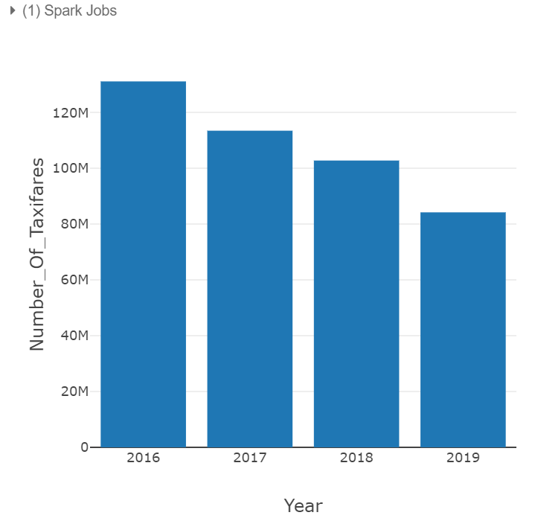
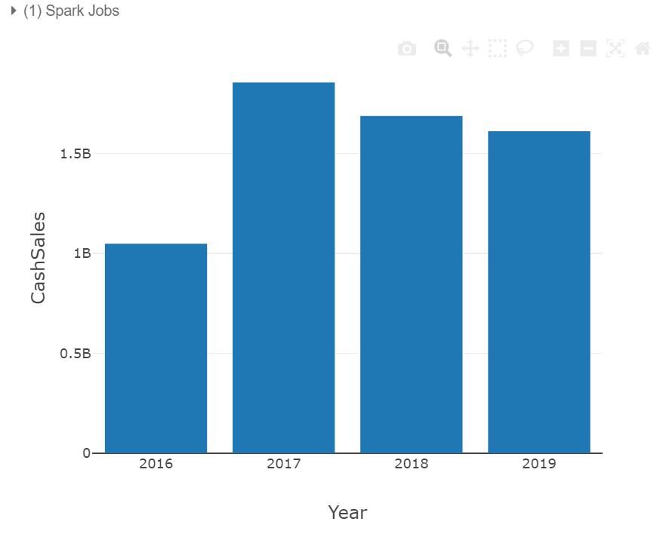
Introducing the data sources
Data source #1 – Number of taxi fares by calendar year (left visual)
Data source #1 – Cash Sales of taxi fares by calendar year (right visual)

Slide 5
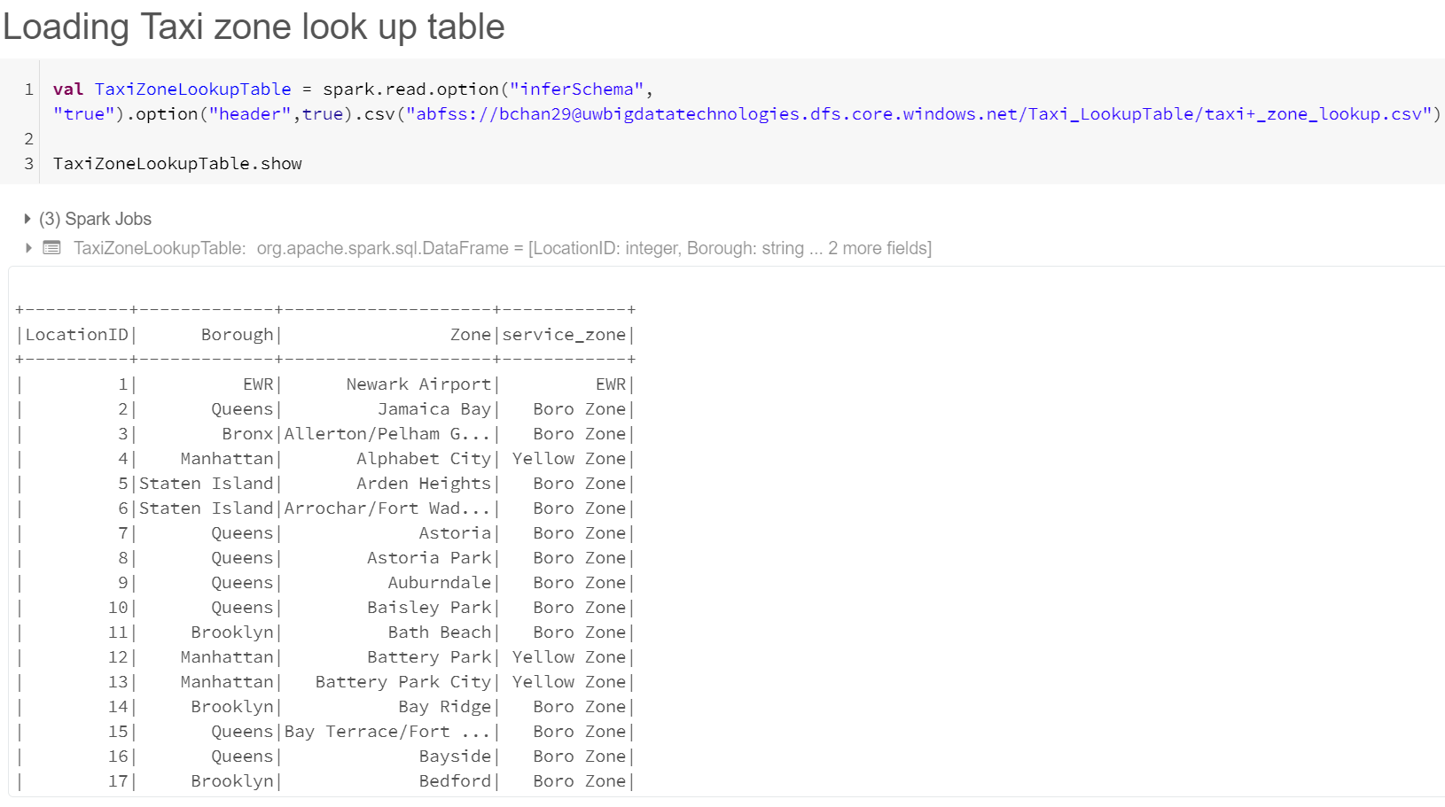
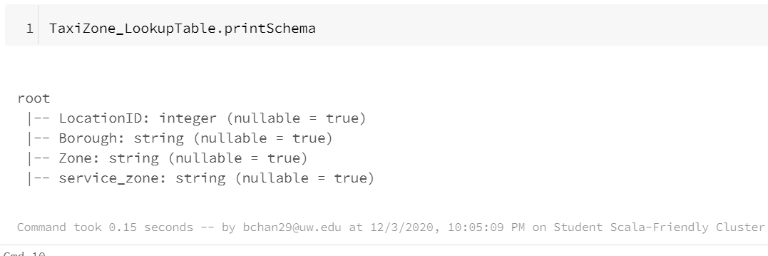
Introducing the data sources
Data source #2 captures a look up table for location zones and service zones by joining the LocationID.

Slide 6
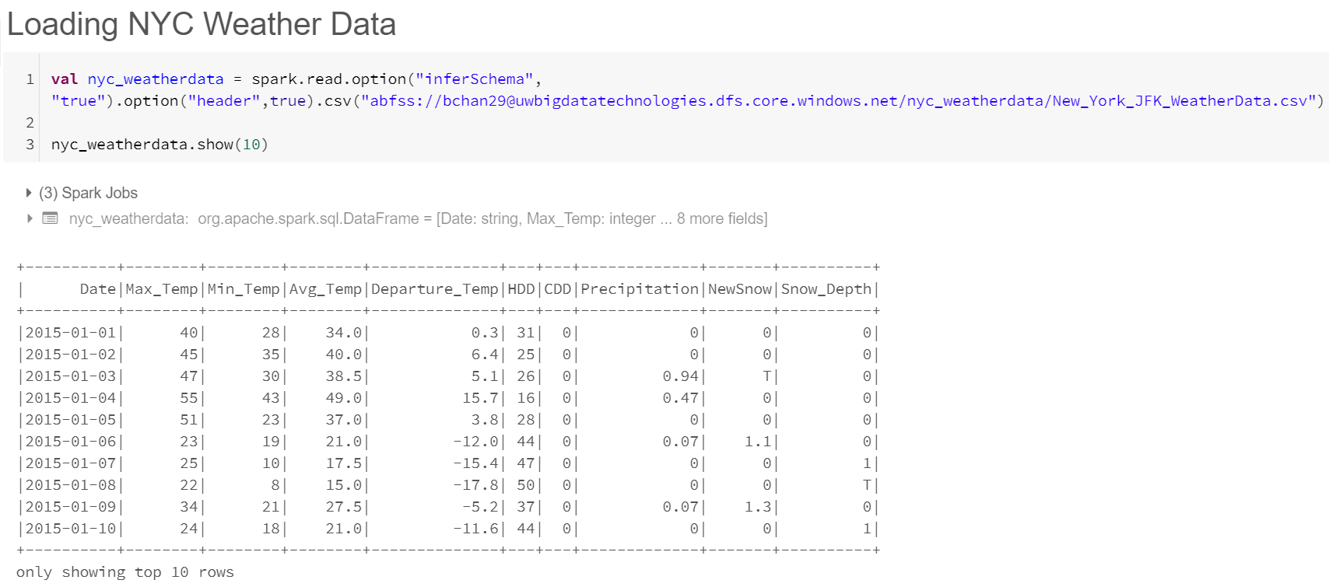
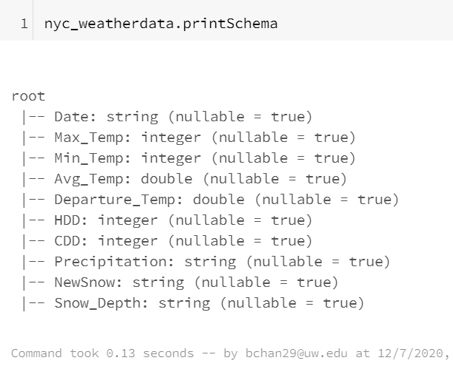
Introducing the data sources
Data source #3 captures weather data from 2016 to 2019 for New York JFK Airport. I will be using this data source to generalize the weather in New York City.

Slide 7
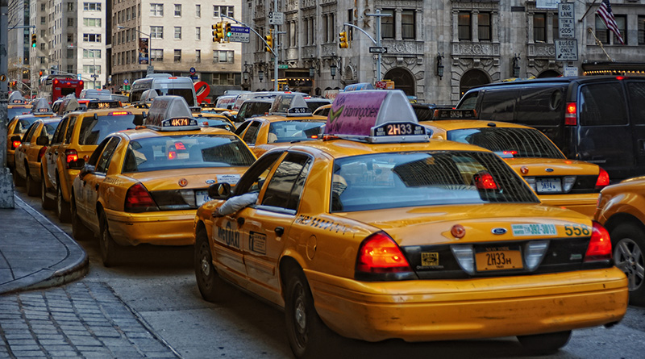
Objective of the project
Main Question: Should yellow taxi cab drivers be more strategic when picking up customers rather than picking up whoever?

Slide 8
Objective of the project
Investigating questions before proposing a solution to the “Main Question”:
Do specific weather conditions lead to more cash sales?
Which weekday and time of day tends to result in more cash sales?
Do more passengers in a taxi ride lead to more cash sales?
Is there a trend that suggests certain payment types are more preferred and lead to more cash sales?
Which zones should yellow taxi drivers target for more cash sales?
Which pick-up location tend to have more cash sales?
Which drop-off location tend to have more cash sales?
Which taxi fare route tend to have more cash sales?
Which taxi fare route based on least trip distance tend to have more cash sales?

Slide 9

Objective of the project
Decision making: Perform ranking analysis based off the investigated questions to see if there is a trend that may suggests the best strategy for taxi drivers to maximize their revenue

Slide 10
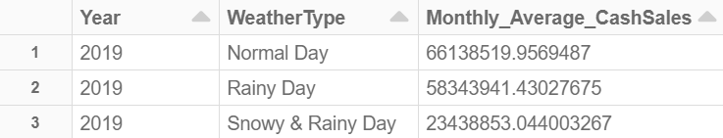
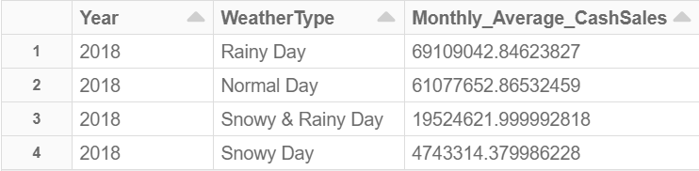
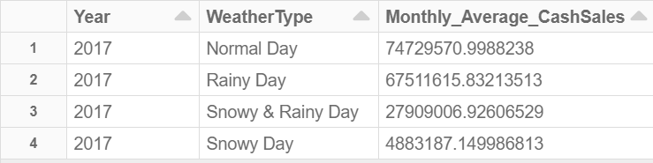
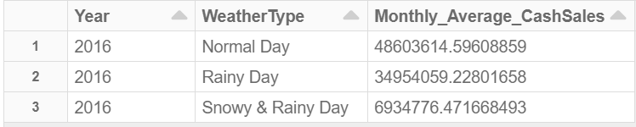
Investigation
Do specific weather conditions lead to more cash sales?

Slide 11
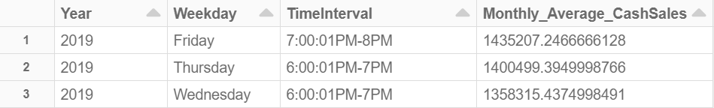
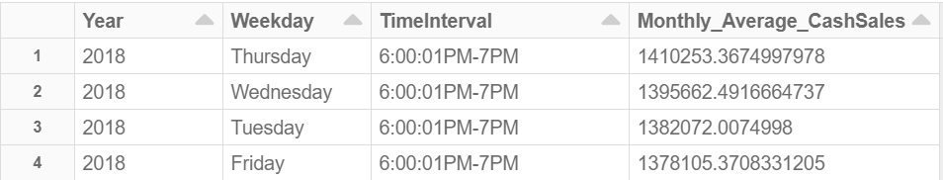
Investigation
Which weekday and time of day tends to result in more cash sales?

Slide 12
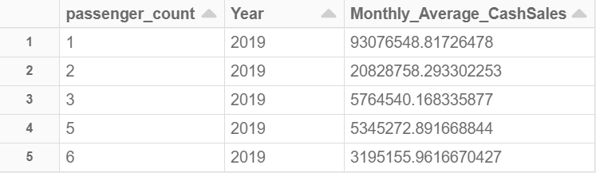
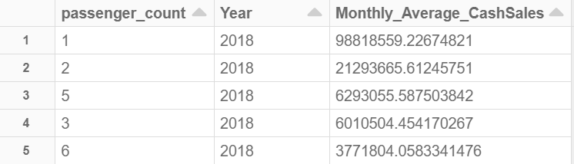
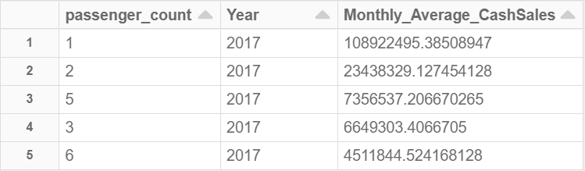
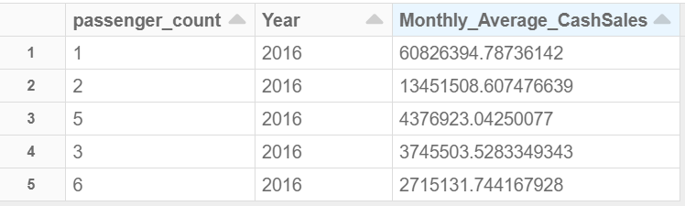
Investigation (Part1)
Do more passengers in a taxi ride lead to more cash sales?

Slide 13
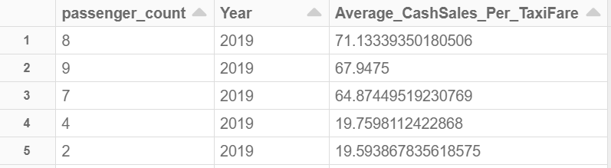
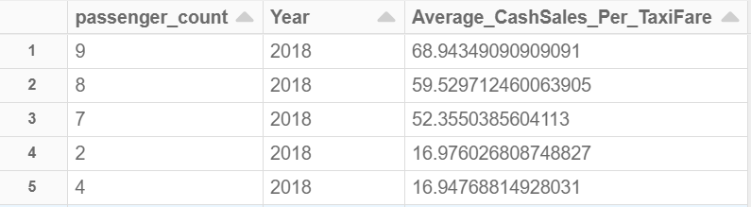
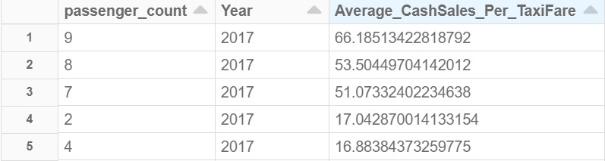
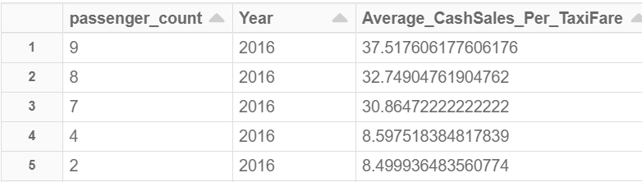
Investigation (Part2)
Do more passengers in a taxi ride lead to more cash sales?

Slide 14
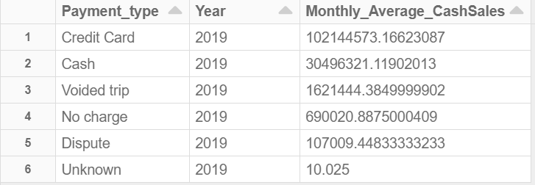
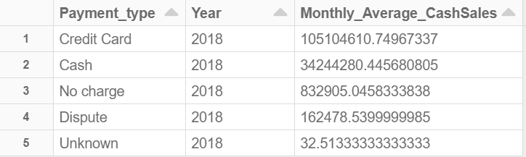
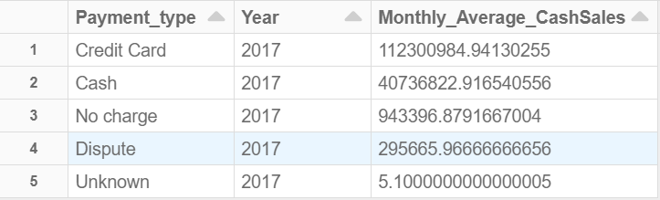
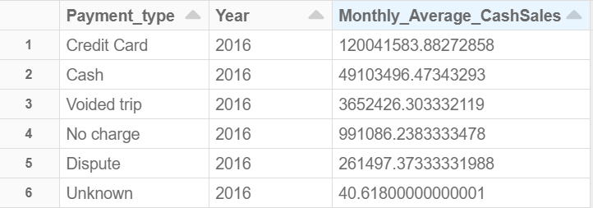
Investigation
Is there a trend that suggests certain payment types are more preferred and lead to more cash sales?

Slide 15
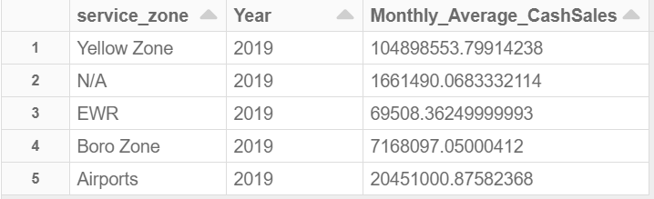
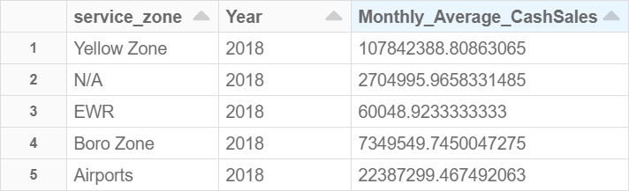
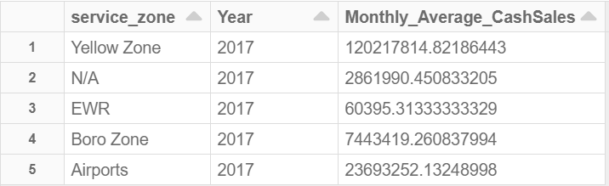
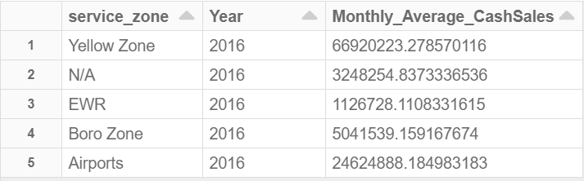
Investigation
Which zones should yellow taxi cab drivers target for more cash sales?

Slide 16
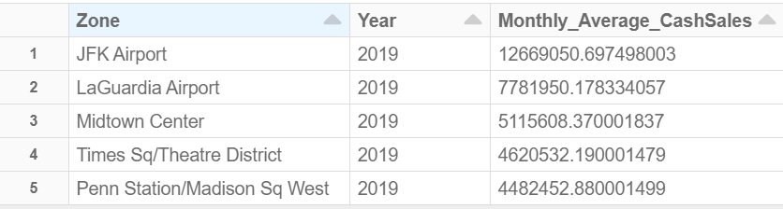
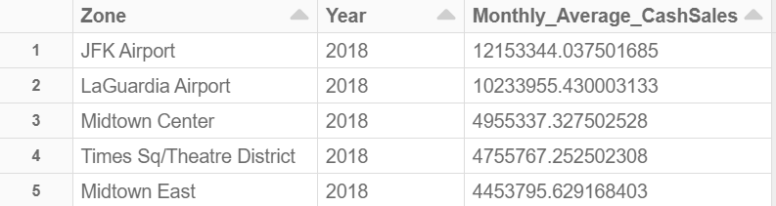
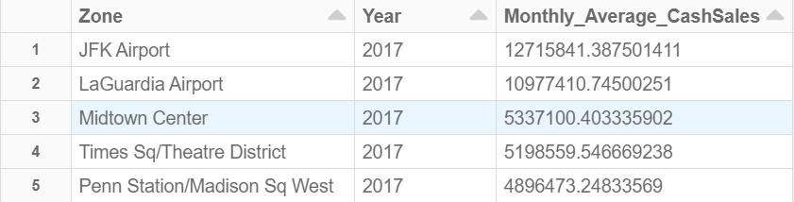
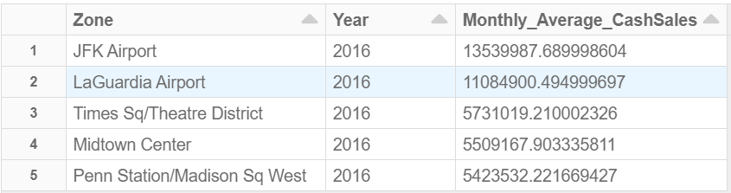
Investigation
Which pick-up location tend to have more cash sales?

Slide 17
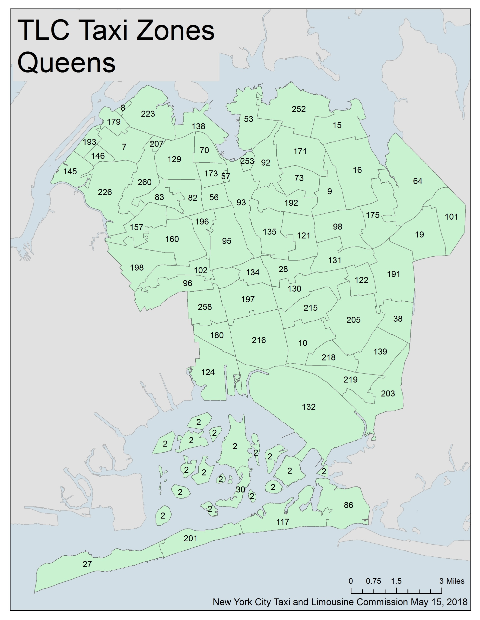

Slide 18
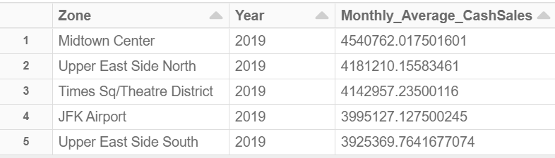
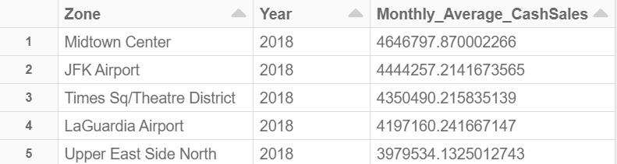
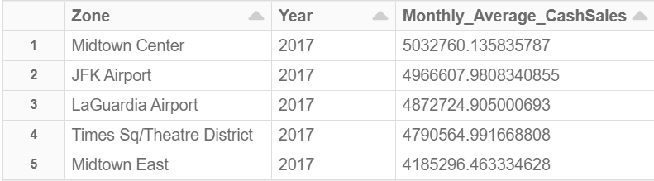
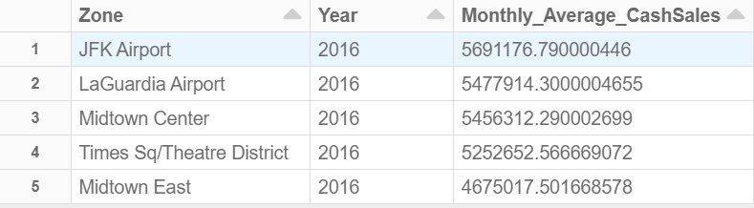
Investigation
Which drop-off location tend to have more cash sales?

Slide 19
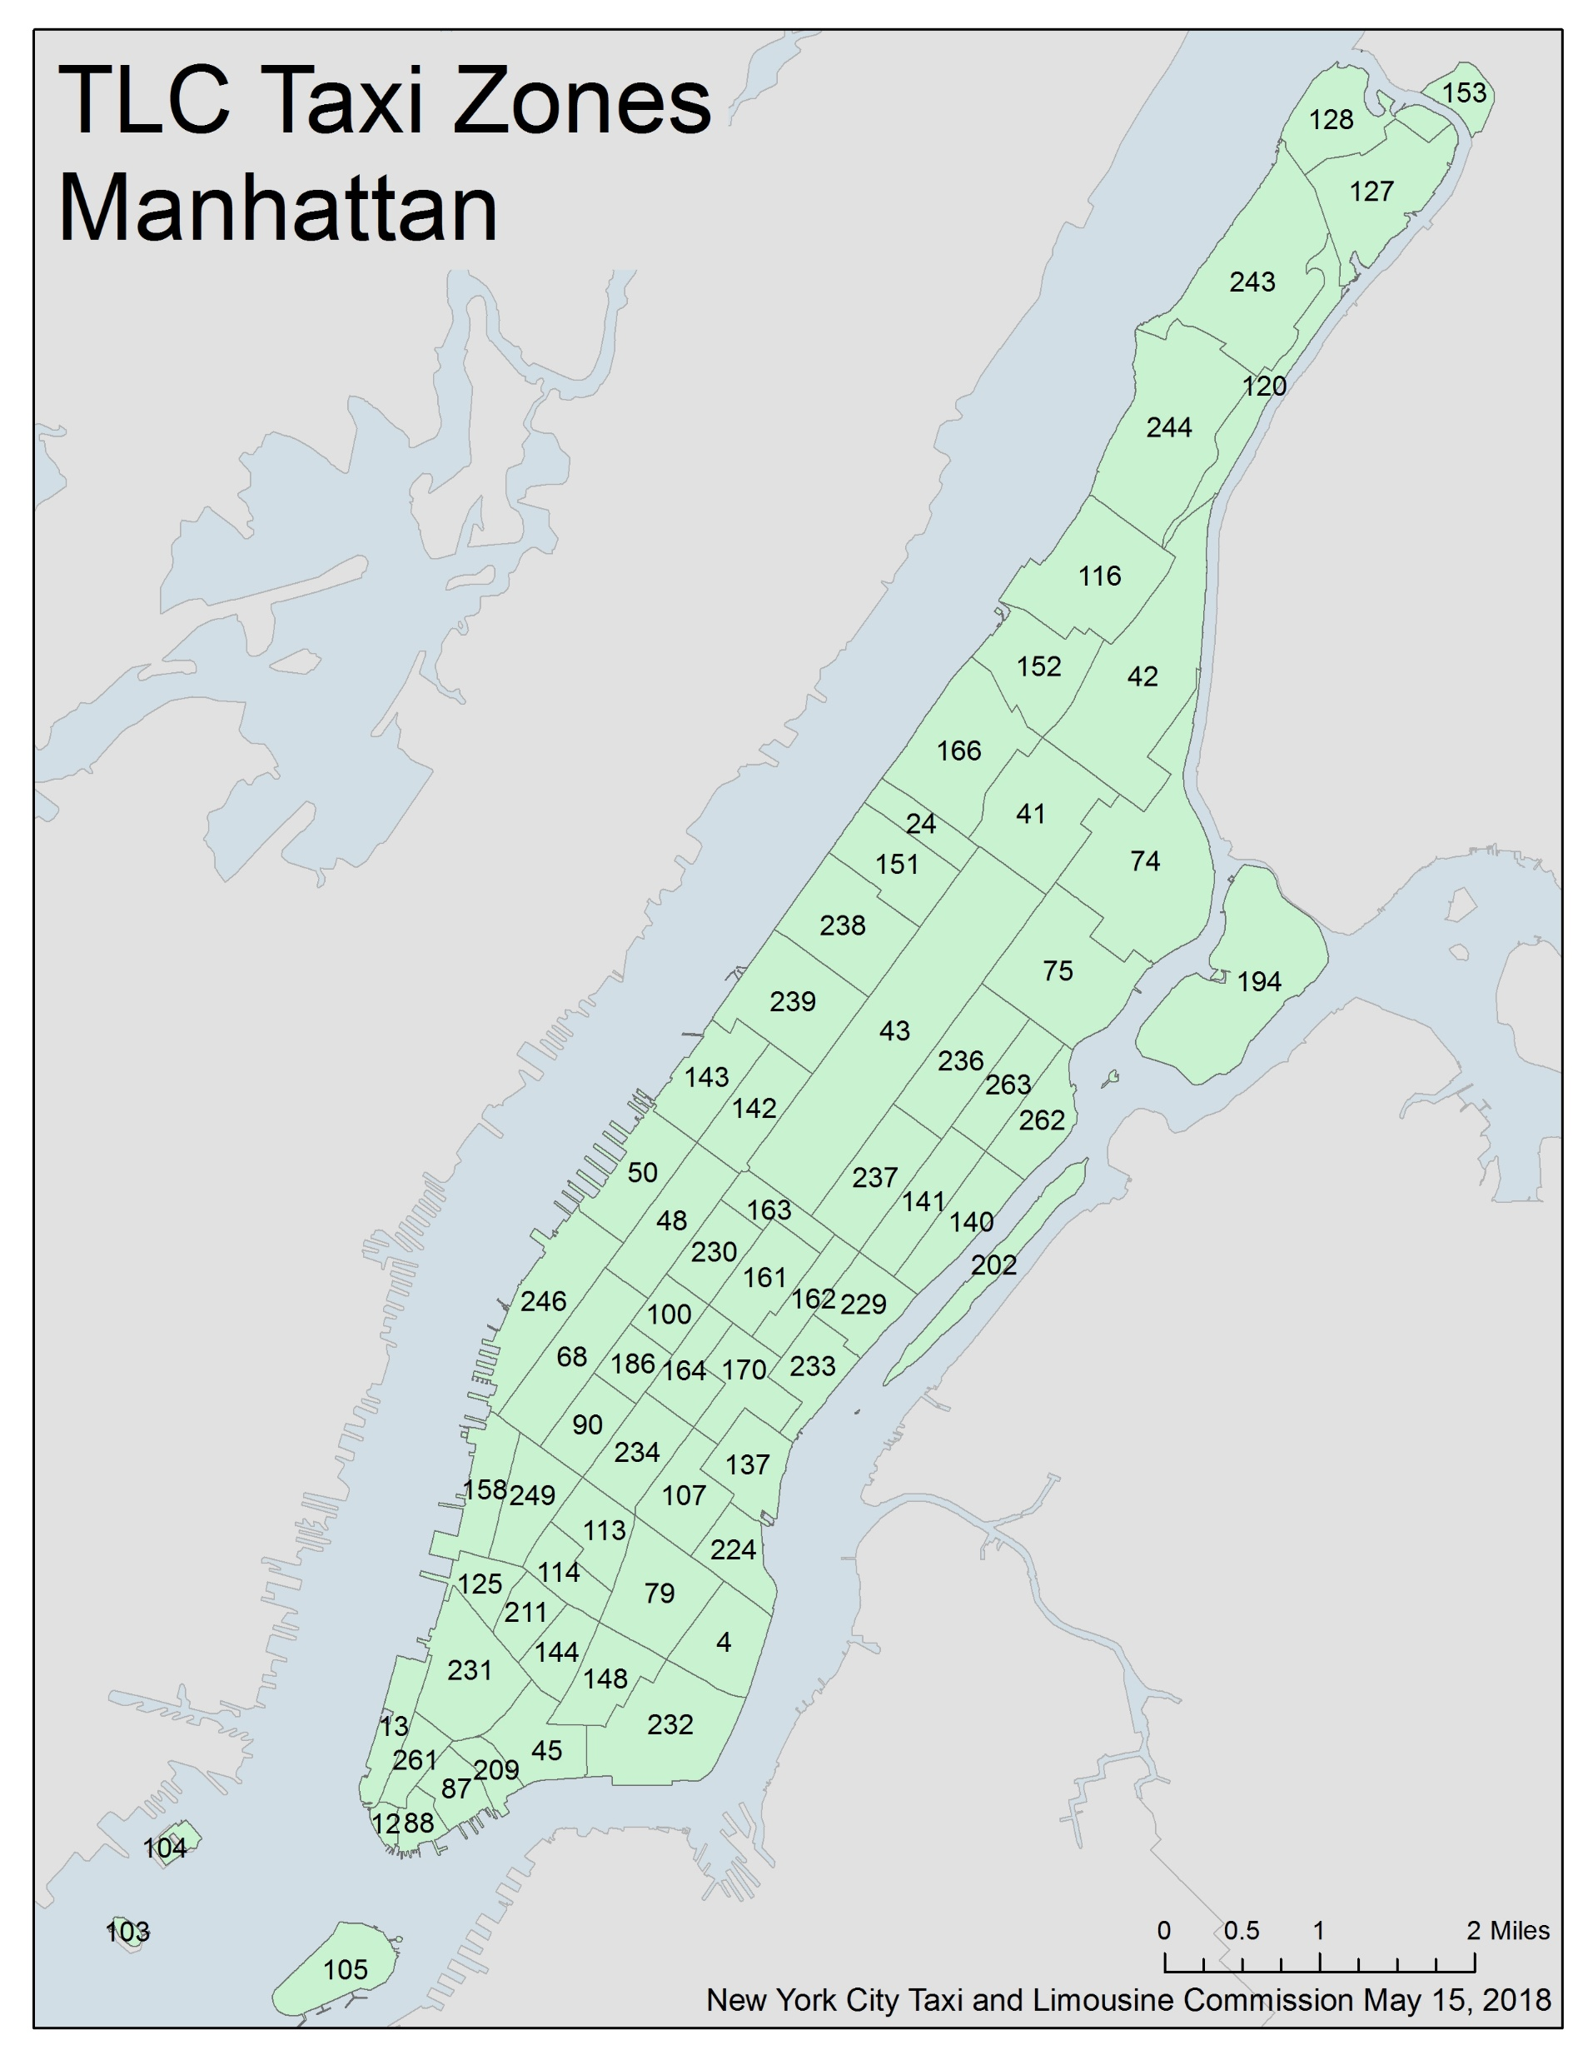

Slide 20
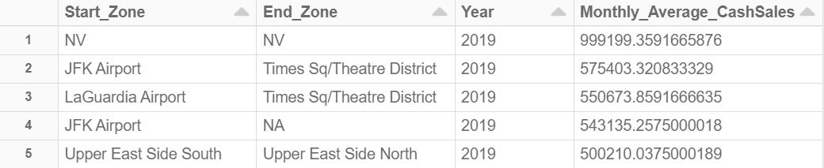
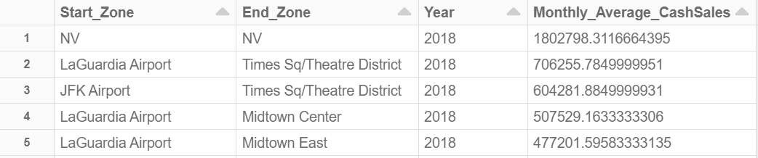
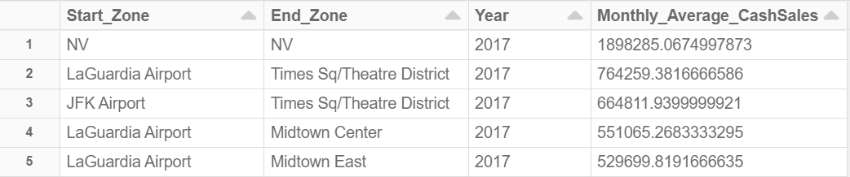
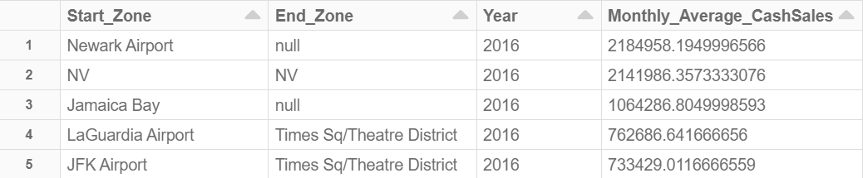
Investigation
Which taxi fare route tend to have more cash sales?

Slide 21
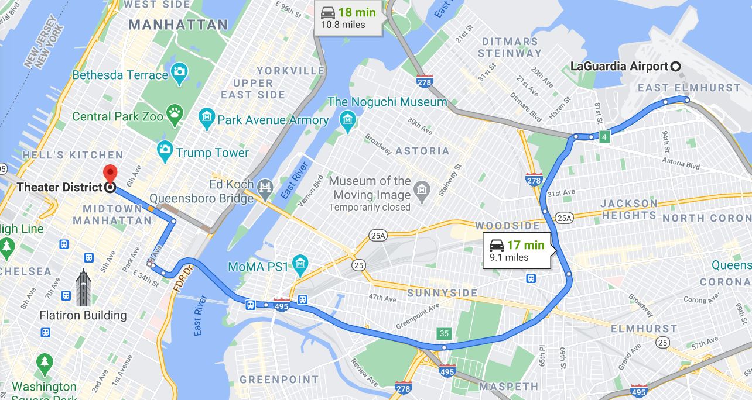
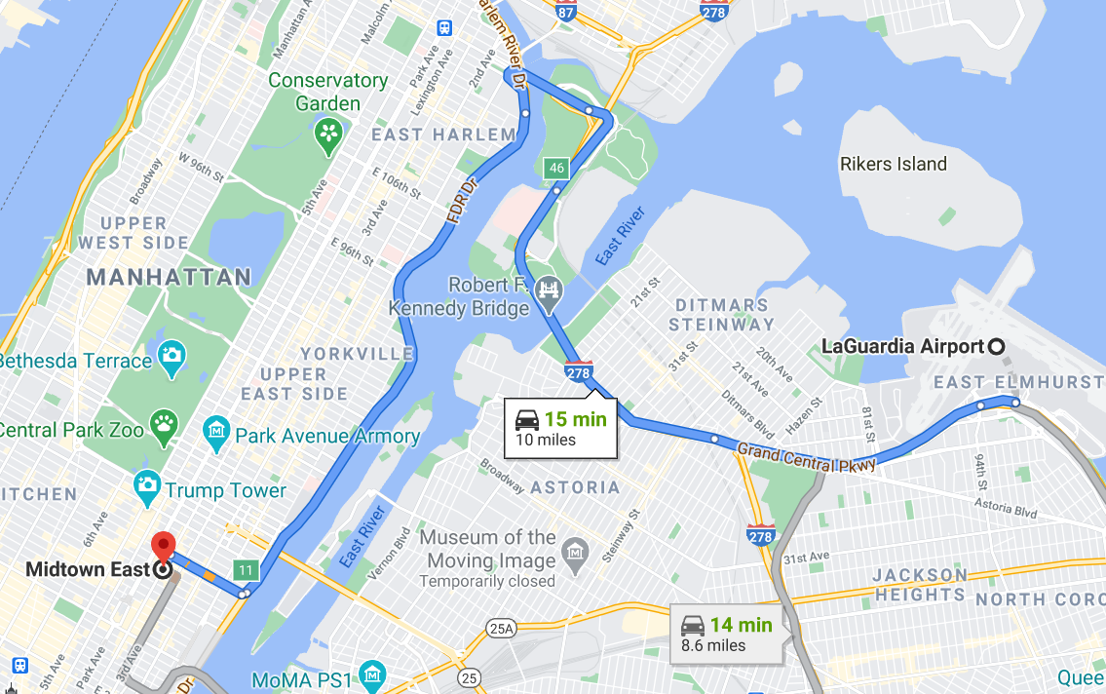
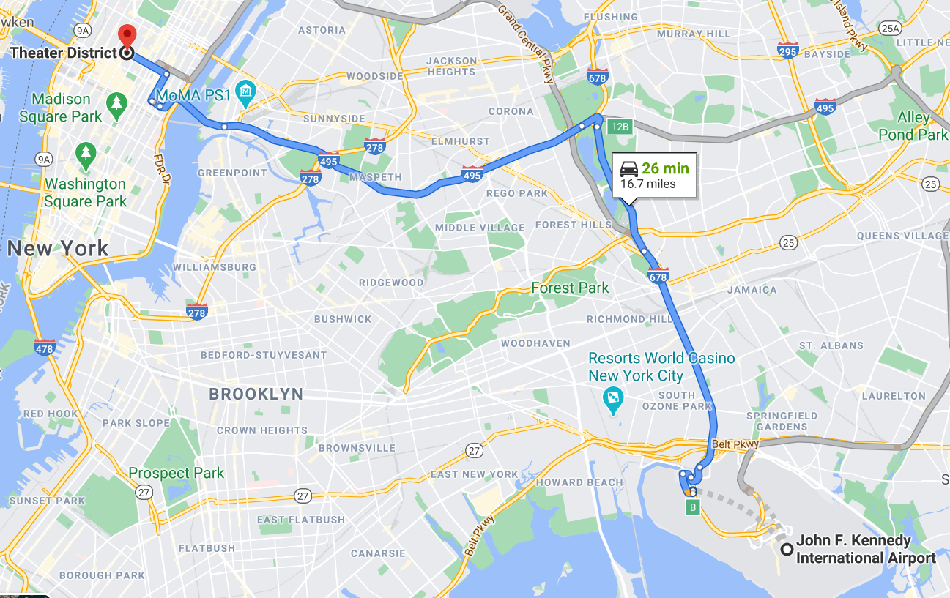
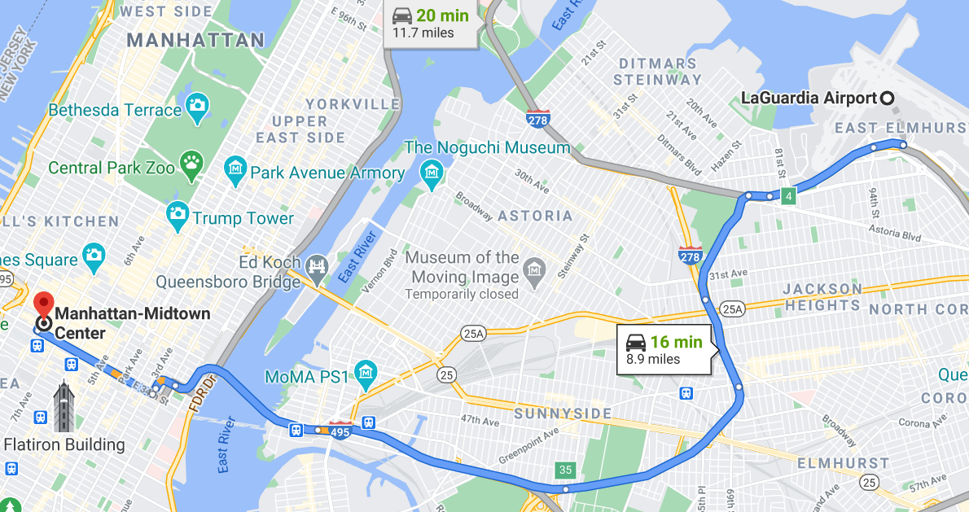

Slide 22
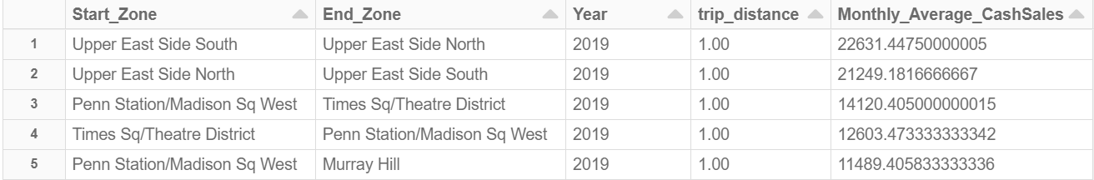



Investigation
Which taxi fare route based on least trip distance tend to have more cash sales?

Slide 23
Results
Below are some strategic approaches based on our investigation for taxi driver to maximize their revenue:
For all 4 years, JFK Airport ranked number 1 for most cash sales based off pick-up location (This makes sense as many customers may be visiting NYC or returning home from their travels)
For 3 out of 4 years, Midtown Center ranked number 1 for most cash sales based off drop-off location
Taxi drivers should target Yellow Zone to maximize their revenue not only because Yellow Zone was ranked #1 in all 4 years but when you make a comparison between rank #1 versus rank #2: 2019: The difference between rank #1 and rank #2 was approximately 103 million or the percentage change was 6213% 2018: The difference between rank #1 and rank #2 was approximately 105 million or the percentage change was 3886% 2017: The difference between rank #1 and rank #2 was approximately 117 million or the percentage change was 4100% 2016: The difference between rank #1 and rank #2 was approximately 63 million or the percentage change was 1960%
Taxi drivers should target groups of 7 or more passengers since the average cash sales per taxi fare ranges from $30 to $70 versus less than $30 for groups of 6 or less passengers.

Slide 24
Results
Below are some strategic approaches based on our investigation for taxi driver to maximize their revenue:
Taxi drivers should be working Monday to Fridays from 6:00PM to 7:00PM as monthly average cash sales is the highest. (This makes sense since this is the perfect time where people are getting off work, going home, going for dinner, etc)
Being aware that credit card is the preferred payments type
Taxi drivers who are looking for only a couple of short distance taxi rides should target the following popular routes: Upper East Side South → Upper East Side North Upper East Side North → Upper East Side South NV → NV West Village → West Chelsea/Hudson Yards Lincoln Square East → Central Park

Slide 25
Results
Below are some strategic approaches based on our investigation for taxi driver to maximize their revenue:
Taxi drivers should target these top 5 routes since these routes have led to most monthly average cash sales during the past 4 years: NV → NV JFK Airport → Times Sq/Theatre District LaGuardia Airport → Times Sq/Theatre District LaGuardia Airport → Midtown Center LaGuardia Airport → Midtown East Upper East Side South →Upper East Side North

Slide 26
Results
Below are some strategic approaches based on our investigation for taxi driver to maximize their revenue:
Taxi drivers should work on non snowy & rainy days as the past has suggested that monthly average cash sales tend to be higher.

Slide 27
Conclusion & Time Constraints
Conclusion
Based on the investigated questions, those were some of the possible solutions for taxi drivers to maximize their revenue.
Some of these recommendations can change over time due to improvement in transportation, new development in buildings, construction on routes, etc
Time Constraints
Figuring out the approximate loss in revenue due to its competitor UBER? Compare yellow taxi drivers versus UBER drivers?
Understand the correlation between variables.

Slide 28
Thank you for listening!
Question?

Slide 29
Image Link Reference
https://dryve.com/will-robotaxis-deal-deathblow-yellow-cabs/
https://www.kindpng.com/imgv/Thxoiwx_podium-first-second-third-place-icon-hd-png/
https://www1.nyc.gov/site/tlc/about/tlc-trip-record-data.page (Data source #1, #2, and map visuals)
https://w2.weather.gov/climate/xmacis.php?wfo=okx (Data Source # 3 – Weather data)
Taxi Fare : $2.00 Initial Charge $0.30 per 1/5 mile $0.20 per minute stopped or slow traffic

